Slide 1
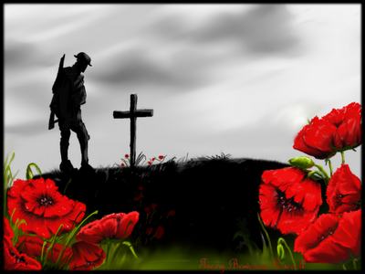
REMEMBRANCE
DAY

Slide 2
REMEMBRANCE
DAY

Slide 3
WHY WE REMEMBER

Slide 22
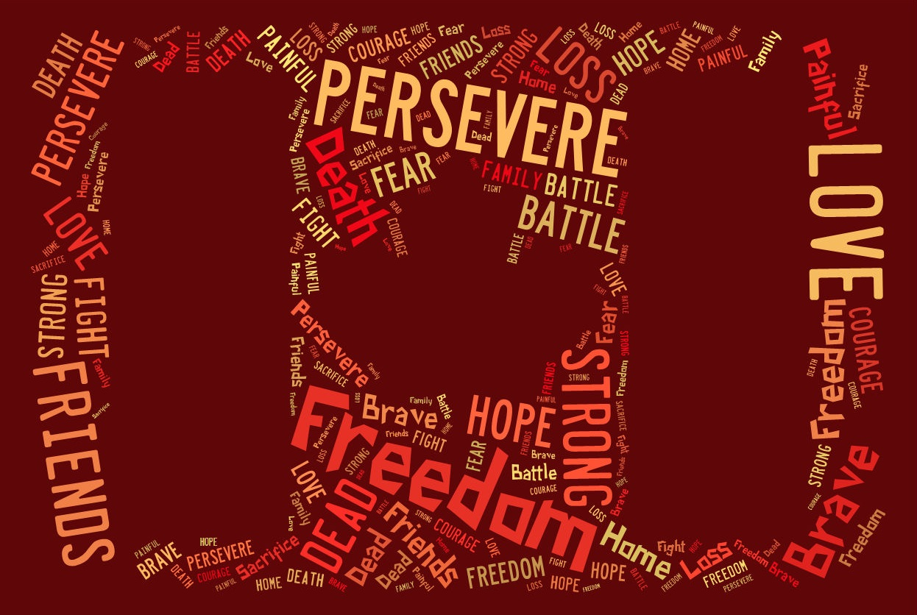

Slide 23
IN FLANDERS FIELDS
Written by Lt. Col. John McCrae, May 1915
In Flanders fields, the poppies blow
Between the crosses, row on row,
That mark our place; and in the sky
The larks, still bravely singing, fly
Scarce heard amid the guns below.

Slide 24
IN FLANDERS FIELDS
Written by Lt. Col. John McCrae, May 1915
We are the Dead. Short days ago
We lived, felt dawn, saw sunset glow,
Loved, and were loved, and now we lie
In Flanders fields.

Slide 25
IN FLANDERS FIELDS
Written by Lt. Col. John McCrae, May 1915
Take up our quarrel with the foe:
To you from failing hands we throw
The torch; be yours to hold it high!
If ye break faith with us who die
We shall not sleep, though poppies grow
In Flanders fields.

Slide 26
IN FLANDERS FIELDS
Words by Lt. Col. John McCrae, May 1915
Music by Craig Cassils
Performed by Grade 3/4/5 Choir

Slide 28
THANK YOU
FOR REMEMBERING WITH US

